Slide 1
2 DTD (Document Type Definition)
Within XML, the editor can use self describing custom tags, to insure the easy reading, extension and clear semantic.
However, excessive/undue freedom brings excessive confusion/chaos, especially in the area of computer processing and information exchange。
If you want to exchange your data with somebody else, or to analysis and retrieve the data with the computer automatically, the data schema is very important.

Slide 2
2.1 Data Schema and DTD
This chapter will introduce the XML data schema, and its describing language
Take DTD as example, to show how to edit data schema for xml data, to insure the validation of the data

Slide 3
2.1.1 usage 1
Without the restriction of data schema，the XML data have features below：
  Unlimited vocabulary table, any name of element and attribute
  No any grammar rule, any content within each element.
  No restriction to attribute, each element can contain any attribute

Slide 4
Usage 2
XML tree model has more stronger ability of expression, and has more expression way for the same data, and results in more difficulty for information exchange and process
We need to define the vocabulary of data for special area, including the name and value of the element and attribute, the grammar rule to control the structure of the xml element
The process to implement the above task, is the design of the data schema for xml data document。

Slide 5
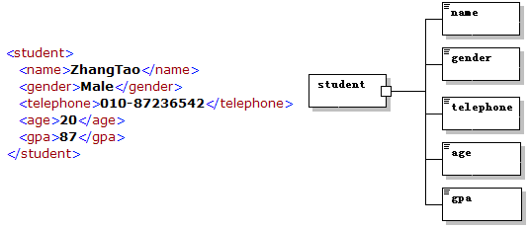
XML data schema example
Through defining the data schema, we can valid the document

Slide 6
2.1.2 DTD
DTD is a standard for SGML, which occurs before XML standard.
DTD can used to create schema for any type SGML, including XML and HTML
DTD describes the vocabulary and grammar of a markup language, and defines the whole structure of the document
DTD is a way to insure the right format of XML document. We can compare the DTD file and XML file, to check the validation by valid whether its element or attribute is right

Slide 7
Advantage of using DTD
Get popular support with program tools and analysis tools. Any browser which can process XML document, can valid the HTML document with comparing to the DTD file
There is so many defined well DTD standard, such as MathDTD、MusicDTD、SVGDTD and so on. In fact, each application of XML, has its own DTD standard
The grammar is a little easy to study

Slide 8
Disadvantage of using DTD
It is not aiming to XML data schema, so there is a limitation when model for XML data
  DTD didn’t use the grammar rule like XML
  DTD couldn’t satisfy the automatically process completely.
    No support namespace

Slide 9
2.2 basic grammar rule of DTD
  To give the inner DTD rule or outer DTD file, for the related XML data；
  To declare a group of permitted elements which can occur in the xml document;
  To define the content model for each element；
  To declare a group of permitted attributes for each element；
  To declare different Entities, including Parameter Entities and General Entities，and the Reference to the entities

Slide 10
2.2.1 To define DTD rule for XML documents
DTD rules are used to describe the data model of the xml data.
DTD rules can occur in the XML document, or in a separated DTD file but related to the aim xml document
In a word, xml document can contain DTD rules for the current document, and can build connection to the outer DTD

Slide 11
Inner DTD rules
The inner grammar rule is below：
<!DOCTYPE root_element [
......
]>
<?xml version="1.0" standalone="yes"?>
<!DOCTYPE student [
...
...
]>
<student>
...
...
</student>

Slide 12
Outer DTD file
It can be shared by more than one DTD file. Once it is edited by a DTD file, it can be referrer by different DTD files
There is private / public DTD files

Slide 13
Private outer DTD file
It is declared as below：
<!DOCTYPE root_element SYSTEM "DTD_location">
Keyword：SYSTEM；
Means this file is used by some developer
DTD_location means its url
<?xml version="1.0" standalone="no"?>
<!DOCTYPE book SYSTEM "book.dtd">
<book>
……
</book>

Slide 14
Public outer DTD
This DTD file is produced by some leading authority, and is usually used by special industry and the public
It is declared by the outer file as below
<!DOCTYPE root_element PUBLIC "DTD_name" "DTD_location">
Keyword public
The file name. which is used to choose the latest version by the parser
If the parser cannot find the DTD file through thDTD_name, it will locate the file by the TD_location instead

Slide 15
DTD_name
"prefix//owner_of_the_DTD//description_of_the_DTD//language_identifier"
prefix can be ISO、+、or -，means the approved ISO standard, the approved non-ISO standard, or the un-approved non-ISO standard
owner_of_the_DTD means the authority or organizer which public this document
description_of_the_DTD means the simple description about this document
Language_identifier means the language
"-//IETF//DTD HTML Strict Level 1//EN"
"-//W3C//DTD XHTML 1.1//EN"

Slide 16
2.2.2 Declaration on Element and its content model
within DTD ，element is declared as below
<!ELEMENT should be UPPER，
element-name is next key word
The type and content model can be given
<!ELEMENT element-name category>
<!ELEMENT element-name (element-content)>

Slide 17
(1). Empty element
Grammar rule：
Example
<!ELEMENT student EMPTY>。This declaration expresses the content of the student element is empty, which can not contain any sub-element or text
<!ELEMENT element-name EMPTY>

Slide 18
(2). Element containing any content
Grammar rule：
Example
  <!ELEMENT stu_bak ANY>,which expresses that element stu_bak can contain any content
<!ELEMENT element-name ANY>

Slide 19
(3). Element containing only text
Grammar rule：
Example
<!ELEMENT stu_name (#PCDATA)>, which expresses that the element stu_name contains only text, but not sub-element
The keyword PCDATA means the Parsed Character DATA by the XML parser，which can not include any Tag except the escape word
<!ELEMENT element-name (#PCDATA)>

Slide 20
(4). Element containing only sub-element
Grammar rule：
In which，(child1,child2,...) expresses a serial 。
<!ELEMENT student (stu_name, stu_no, stu_bak)> , means the element student should contain sub-elements stu_name,stu_no,stu_bak 元素中必须包含 stu_name、stu_no、stu_bak with given order
<!ELEMENT element-name (child1,child2,...)>

Slide 21
Different Symbols in the Content Model
Symbol | Meanng | Examples
, | Used to separate individual element in the sequence | …,Elem1,Elem2,… Elem 1 should be front of Elem2
| | Used to provide element choice before or after the symbol | …,Elem1 | Elem2,… The model can choose elem1 or elem2 in certain position
() | Used to form a group | …,(elem1,elem2)+ Which is different from elem1,elem2+
? | The refer element or group will occur once or not | …,elem1?,… The model can choose elem1 or not in certain position
+ | The refer element or group will occur once or more | …,elem1+,… The model can choose elem1 more than one time in certain position
* | The refer element or group will occur more than 0 time | …,elem1*,… The model can choose elem1 more than zero time in certain position

Slide 22
Example of content model for element
①.<!ELEMENT note (to,from,header,(message|body))>
②.<!ELEMENT article (title, subtitle?, author*, (para | table | list)+,
bibliography?)>

Slide 23
(5). Element containing given sub-element and text
Grammar rule：
Example
<!ELEMENT para (#PCDATA | emphasis | xref)*> means element para can contain any text, and any order of the text and sub-element
It should put #PCDATA in front any element
<!ELEMENT element-name (#PCDATA | child1 | child2 | ...)*>

Slide 24
2.2.3 Declaration on attribute
Grammar Rule：
For more than one attribute：
Two attribute in element can be written as ：
<!ATTLIST element-name attr-name attr-type attdesc>
<!ATTLIST element-name attr1 attr-type1 attdesc1
attr2 attr-type2 attdesc2
>
<!ATTLIST element-name attr1 attr-type1 attdesc1>
<!ATTLIST element-name attr2 attr-type2 attdesc2>

Slide 25
attr-type in attlist
type | meaning
CDATA | “Character data”，not containing transferred data The tag in the text will not be treated as tag.
(value1|value2|..) | It is a enumeration consist of value1、value2…，and the value of attribute should be in the enumeration
NMTOKEN | The value of the attribute should be valid XML tag (name Token）。
NMTOKENS | more than one NMTOKEN, which is separated by space.
ID | The value of the attribute is unique in the document
IDREF | The value of one attribute refers another ID of attribute
IDREFS | more than one IDREF, which is separated by space.
ENTITY | The value of the attribute is an Entity
ENTITIES | more than one ENTITY, which is separated by space.
NOTATION | The value of the attribute is a name of NOTATION

Slide 26
attdesc in ATTLIST
attdesc | meaning
value | The default value of the attribute
#REQUIRED | The attribute is required
#IMPLIED | The attribute is option
#FIXED value | The value of the attribute is fixed data

Slide 27
Example 1
①. <!ATTLIST memo id ID #REQUIRED
security (high|low) "high"
keywords NMTOKENS #IMPLIED
>
Attribute id of element memo is required，and the value is unique in this document, the value of attribute security may be "high" or "low“, but the default value is "high"；attribute keywords is optional, and its value should be more than one XML tag separated by space
keywords = "XML XPath XQuery"、id="memo-2006-03-14“
Are both correct value
②. <!ATTLIST sender company CDATA #FIXED "Microsoft">
The value of attribute company in element sender is CDATA, which is fixed "Microsoft"。
<sender company=“Microsoft” /> is corrent
<sender company="Schools" /> is wrong

Slide 28
Example 2
③. <!ELEMENT Step EMPTY>
<!ATTLIST Step id ID #REQUIRED>
<!ELEMENT StepLink EMPTY>
<!ATTLIST StepLink steps IDREFS #IMPLIED>
If there is：
<Step id="step1"/>
<Step id="step2"/>
<StepLink steps="step1 step2"/> is correct
④. <!ATTLIST bulletlist icon ENTITY #IMPLIED>
<!ENTITY bluedot SYSTEM "icons/bluedot.png">
<!ENTITY greendot SYSTEM "icons/greendot.png">
<bulletlist icon="bluedot">
Or <bulletlist icon="greendot"> are both correct

Slide 29
2.3 Edit DTD within XMLSPY
1. New DTD Document
2. Edit DTD Document
3. Generate XML instances document
4. Generate DTD document
5. Valid the XML instances document
6. Edit XML instances document with DTD

Slide 30
2.2.4 Classify and Declaration on Entity
Entity is an important tag in DTD
It is a placeholder for some content, and declared once, but used by more than one place
It aims to edit, maintain and read the XML document more easily
Entity can contain single character, string and XML segment

Slide 31
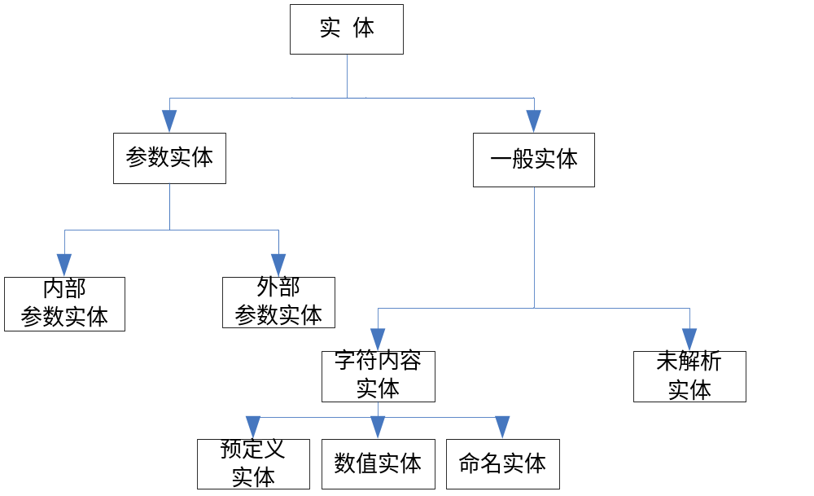
Classify on Entity
For different position，Entity can be classified into two class Parameter Entity and General Entity。

Slide 32
Inner Parameter Entity
Parameter Entity is used to hold-place in DTD rules
Inner Parameter Entity means the declaration and reference should be in the same DTD。
Parameter Entity can not contain XML text, and can not occur in XML document
Grammar rule：
<!ENTITY % entity-name “entity_value”>。
Declaration: Percent % is separated by entity-name with a space
Reference：%entity-name;，there is no space between percent % and entity-name

Slide 33
example
<?xml version="1.0" standalone="no"?>
<!DOCTYPE student [
<!-- DTD example-->
<!ENTITY % p "(#PCDATA)">
<!ELEMENT student (id,surname,firstname)>
<!ELEMENT id %p;>
<!ELEMENT surname %p;>
<!ELEMENT firstname %p;>
]>

Slide 34
Outer Parameter Entity
Equivalently import an outer file
Grammar rule：
<!ENTITY % entity-name SYSTEM "URI">
或者
<!ENTITY % entity-name PUBLIC "public_ID" "URI">

Slide 35
example
<?xml version="1.0" standalone="no"?>
<!DOCTYPE student [
<!ENTITY % studentdtd SYSTEM "http://example.org/student.dtd">
%studentdtd;
]>

Slide 36
General Entity
General Entity is used to hold-place in XML data
For different content, it can be classified into ：
  Character Content Entity
    Named Entity
    Pre-definition entity
    Numeric entity
  Un-parsed entity

Slide 37
Character Content Entity-
Named Entity
Declaration Grammar：
Reference Grammar：
It is different Parameter Entity
<!ENTITY entity-name "entity_value">
&entity-name;

Slide 38
Named Entity- Example1
<?xml version="1.0" standalone="yes" ?>
<!DOCTYPE author [
<!ELEMENT author (#PCDATA)>
<!ENTITY us "You and me">
]>
<author>&us;</author>

Slide 39
Named Entity- Example2
<?xml version="1.0" standalone="yes" ?>
<!DOCTYPE author [
<!ELEMENT author (#PCDATA)>
<!ENTITY % who "You & me">
<!ENTITY us "Just %who;">
]>
<author>&us;</author>
<?xml version="1.0" standalone="yes" ?>
<!DOCTYPE author [
<!ELEMENT author (#PCDATA)>
<!ENTITY who "You &amp; me">
<!ENTITY us "Just &who;">
]>
<author>&us;</author>

Slide 40
Named Entity- Example3
<?xml version="1.0" standalone="yes" ?> <!DOCTYPE book [ <!ELEMENT book (#PCDATA|segment)*> <!ELEMENT segment (#PCDATA)> <!ENTITY seg SYSTEM "seg.xml"> ]> <book>Following content comes from another file &seg;</book> (a). book.xml | <segment> segment1 </segment> (b). seg.xml

Slide 41
Character Content Entity-
Predefinition Entity
<、 >、”、 ’、 &，
&lt;、&gt;、&quot;、&apos;、&amp;。

Slide 42
Character Content Entity-
Numeric Entity
No need to define, and can be used
In a word, the number is related to Unicode Code
<title>&#x5B66;&#x4E60;&#x58;&#x4D;&#x4C;</title>
Is parsed as：<title>学习XML</title>

Slide 43
Un-parsed Entity
Some binary file (image, audio, video) can be related to the XML data，and the parser can not parse this data, but can analysis it with some special application

Slide 44
example
<?xml version="1.0" standalone="no" ?>
<!DOCTYPE img [
<!ELEMENT img EMPTY>
<!ATTLIST img src ENTITY #REQUIRED>
<!NOTATION gif SYSTEM "gif-viewer.exe">
<!ENTITY logo SYSTEM "logo.gif" NDATA gif>
]>
<img src="logo"/>

Slide 45
2.2.5 mixture of inner and outer DTD
use <!DOCTYPE ... ]> to declare the inner DTD rule
use SYSTEM or PUBLIC to import outer DTD file
<?xml version="1.0" standalone="yes" ?> <!DOCTYPE note SYSTEM "extra1.dtd"[ <!ELEMENT details (#PCDATA)> ]> <note> <to>Tom</to> <from>Jerry</from> <details>Catch me!</details> </note> (a). note1.xml | <!ELEMENT note (to, from, details)> <!ELEMENT to (#PCDATA)> <!ELEMENT from (#PCDATA)> (b). extra1.dtd

